Slide 1
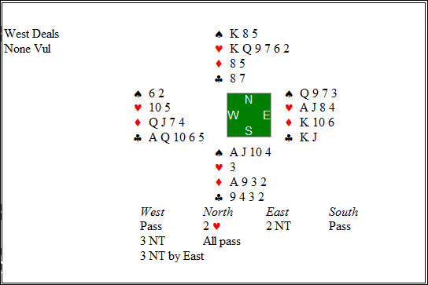
Bridge (and Card Games) in General
https://en.wikipedia.org/wiki/Computer_bridge (kind of outdated!)

Slide 2
Challenges of Playing Bridge Well
https://en.wikipedia.org/wiki/Contract_bridge
Bridge requires a lot of real-time decision making in uncertain environments.
The distribution of the opponents’ and partner’s cards is initially unknown and follows the laws of probability. However, as bids are made and cards are played these initial probabilities change → quite difficult to automate (➔belief networks). Consequently, intelligent play has to consider a large number of states (hand distributions) which have different probabilities: https://en.wikipedia.org/wiki/Contract_bridge_probabilities
Defenders have to collaborate and employ complex signals for this purpose—but declarer is also listening…
There is a huge amount of domain specific knowledge on how to bid and how to play the hand → difficult to computerize
Declarer play requires planning!
Determining the best plan to play a hand is very difficult; determining the best line of play with all hands visible is easy → Deep Finesse—double dummy Bridge is a solved problem: http://www.deepfinesse.com/ does the job: Example: http://www2.cs.uh.edu/~ceick/ai/DeepFinesse.pdf
Players false card or do others things to mislead the declarer (and frequently also partner).
Concealment (not giving (much) information about your actual hand in bidding and play) is an important element of top-level Bridge.

Slide 3
Status of Bridge Software
Bridge programs have reached some maturity and play at a “good” but not “excellent” amateur level, but are still quite for away to play the top level or to win a contest with the best Bridge teams
In Zia Mahmood's book, Bridge, My Way (1992), Zia offered a £1 million bet that no four-person team of his choosing would be beaten by a computer. A few years later the bridge program GIB, brainchild of American computer scientist Matthew Ginsberg,^{[3]} proved capable of expert declarer plays like winkle squeezes in play tests. In 1996, Zia withdrew his bet. … Zia beat various computer programs, including GIB, in an individual round robin match.^{[5]}
Bridge Software is used by professional players and not so good players to enhance their game and companies make money selling their Bridge software.
Using Deep Finesse () results are used as feedback to find the optimal line of play for defense/declarer using the min-max algorithm: depth 13 is not a problem for state of the art computer hardware.
to serve as robots, filling in as the 2nd, 3rd, and 4th player in a Bridge Game..
Using hand generators for bidding training
Finding out the likelihood of a particular hand patterns to enhance bidding systems
Educational software is available to enhance declarer play, defense, and bidding for almost all levels.
Other companies provide services to watch and play Bridge online
2016 Word Championship: http://www.worldbridge.org/repository/tourn/wroclaw.16/Microsite/Participants.asp Watch life on Bridge Base: http://www.bridgebase.com/

Slide 4
Concealment Example
8 7 3 (visible)
K Q 9 10 5 4
A J 6 2
Card Rankings: A>K>Q>J>10>9>8>7>6>5>4>3>2
Play: The West player plays the K, dummy plays the 3, the east player plays the 4 (standard carding: low asks not to continue the suit and high asks to continue the suit); should declarer play the 6 or 2?

Slide 5
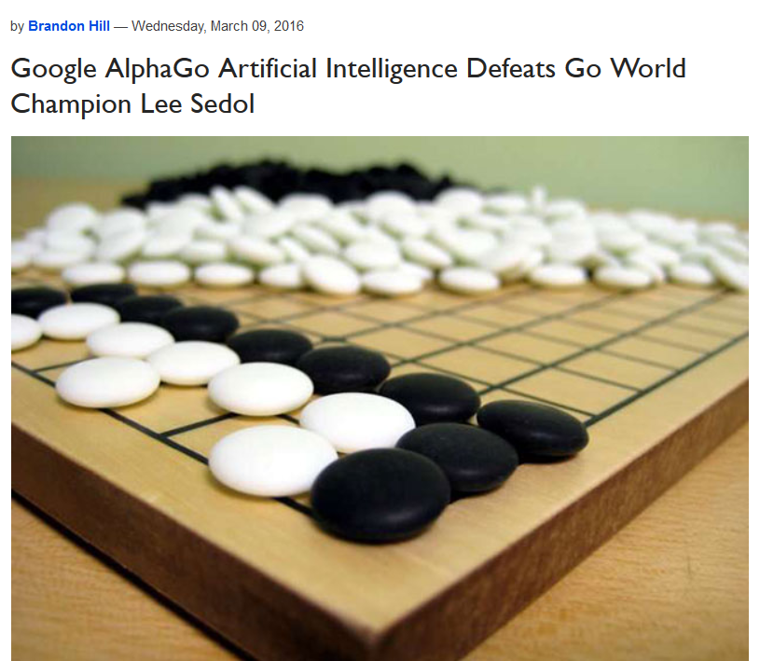
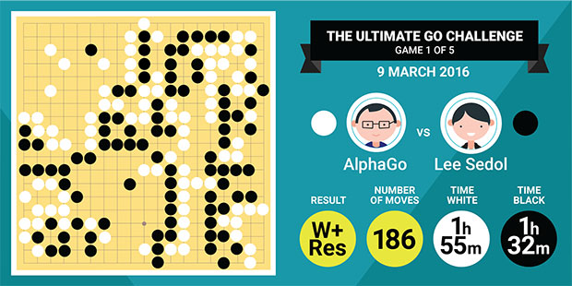
Larry Shi’s slide

Slide 6

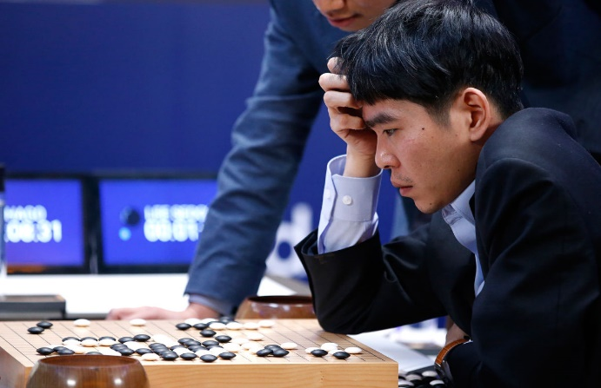
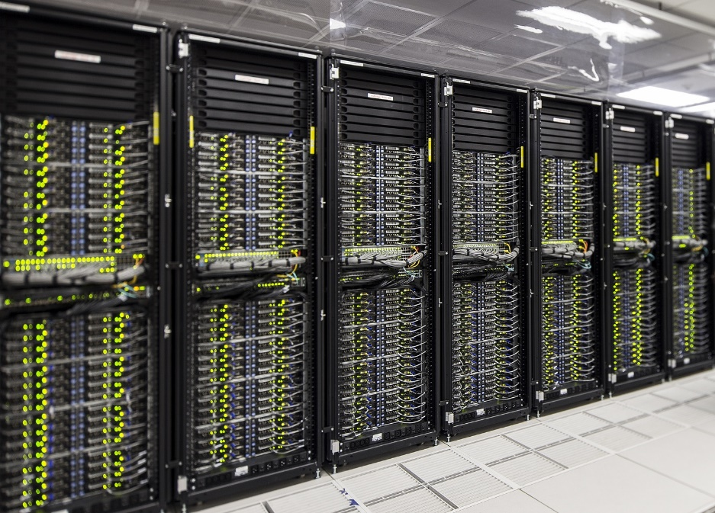
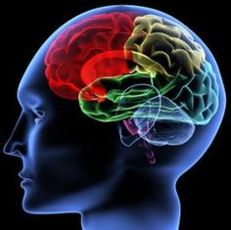
Larry Shi’s slide
Unfair Game?
50KW?
20W

Slide 7
Man vs. Machine—AI & Other Games
In 2005, 3 top chess players lost 8-4 against 3 Chess programs, augmented by state of the art high performance computing equipment—only one game was won by a human player, the machines won 5 games and there were 6 ties; for more details see: https://en.wikipedia.org/wiki/Human%E2%80%93computer_chess_matches ; other information about Computer Bridge: https://en.wikipedia.org/wiki/Computer_chess
As far as Backgammon is concerned, AI and evolutionary computing approaches software is capable to play top level Backgammon.
This year at the Angry Bird Video Game Contest at IJCAI 2016, humans beat all computer programs at all game difficulty levels 1-4: still some hope for mankind! More about this on September 29 when 3 of your class mated give a presentation about this contest!

